Slide 1
Clarifications and Communication
Hypotheses

Slide 2
Hypotheses
Main Hypotheses:
Acquirers will have positive abnormal returns from M&A.
Targets will have positive abnormal returns from M&A.
Sub Hypotheses
Abnormal returns will vary by industry. This is due to industry specific attributes (Sudarsanam & Gao 2003).
Abnormal returns will vary by transaction value. Larger transactions will prompt larger returns due to increased opportunities for synergies (Healy, Palepu and Ruback in 1992).
Abnormal returns will vary by relative size. This reflects investor concern on risk associated with the transaction (acquiring side) and bargaining power (target side) (Meinshausen and Schiereck 2011).
Other Hypotheses are included in my thesis.
Flow Chart

Slide 3
To the right is a complete flow chart of how my thesis is motivated. The next three slides will show this flowchart broken into three sections. Each slide will have click links to allow you to explore the steps that make up that section.
Go Back
Data Collection

Slide 4
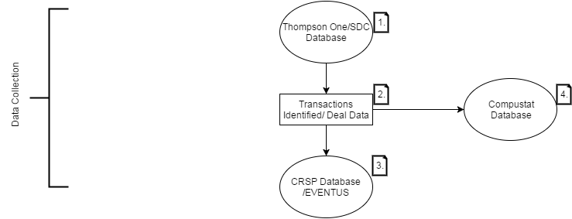
Data Collection
1.
2.
3.
4.
Go Back
Event Study Portion

Slide 5
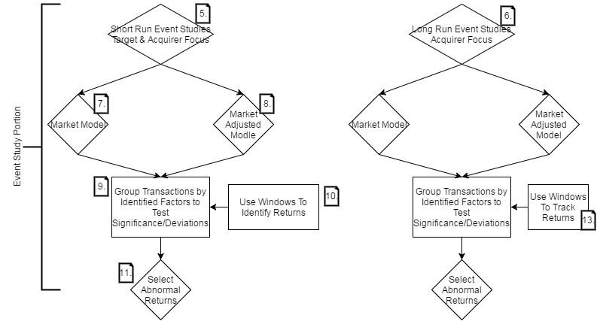
Event Study
5.
6.
7.
8.
9.
10.
11.
13.
Go Back
OLS Regressions

Slide 6
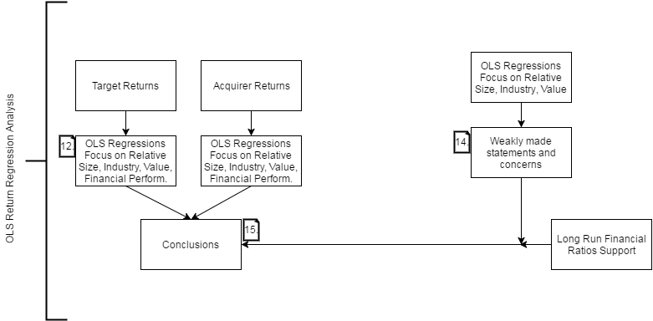
OLS Regressions
12.
14.
15.
Go Back

Slide 7
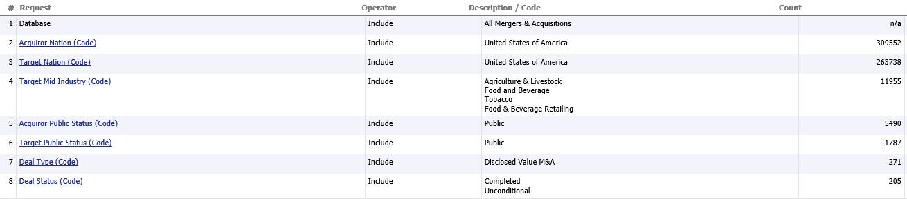
Thompson One/SDC Database
1.
Seven noteworthy query criteria are used to select the approximately 200 transactions from Thompson One used in our study. The next slide will discuss the motivations for choosing these criteria and their implications to our study.
Next Slide

Slide 8
Criterion
1.
Criteria | Notes/Motivating Factors
Criteria 2 & 3: Acquirer Nation US, Target Nation US | Provides a standardized dataset to study in a safe and regulated market. Important because unprotected markets may influence investor driven perceptions and returns (Flugt 2009).
Criteria 4: Target Industry | These were identified as the most ag/food value chain oriented Thompson One industry classifications.
Criteria 5 & 6: Acquirer Public Status, Target Public Status | Provides a standardized dataset. Since much of the price shifts being studied are driven by investor perception, choosing public companies as a focus limits the ambiguous speculation of investors while maximizing the transaction data available.
Criteria 7 & 8: Disclosed Value & Deal Status Code | Rather intuitive criteria. It would be difficult to obtain meaningful results from incomplete transactions or with missing data.
Return

Slide 9
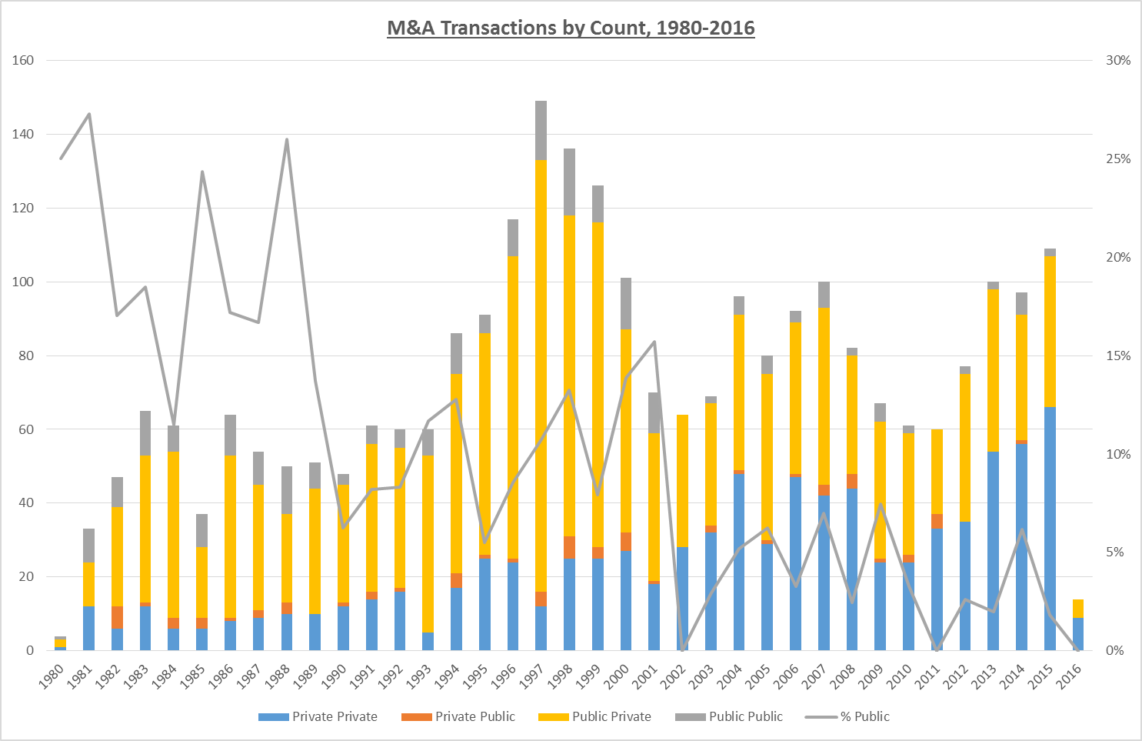
Transactions Identified
2.
Legend
The graph displays the number of M&A transactions broken into four sub segments according to the Thompson database. The four segments below list the Acquirer's status first, followed by the targets status. According to this key, the gray bars labeled Public Public represent public acquirers who performed an M&A transaction with a public target. They gray line represents the percent these transactions reflect the total M&A transaction count in a given year.
Next Slide

Slide 10
Deal Data:
2.
Variable | Definition
Value of Transaction ($mil) | The value of the transaction in millions of dollars.
Relative Size | A transaction size proxy using Target Sales LTM / Acquirer Sales LTM.
Acquirer ROA | Acquirer Net Income / Acquirer Total Assets.
Target ROA | Target Net Income / Target Total Assets.
Industry Dummy (x3) | A binary variable dependent on the targets industry (Ag, Food & Bev, Food & Bev Retailing).
Payment Dummy (x3) | A binary variable dependent on the deal’s payment structure of stock, cash, stock-cash mix, or other financing structure.
Friendly Transaction | A binary variable denoting whether the transaction was friendly or hostile.
Multiple Considerations | A binary variable denoting whether there were three or more bidders for a target company.
Related Industry | A binary variable denoting whether the acquiring and target company where listed in the same Thompson One industry category.
Next Slide

Slide 11
Deal Data
2.
 | Value of Transaction ($mil) | Relative Size | Target ROA | Acquirer ROA | Target Roe
Mean | 1030.73 | 1.25 | 0.01 | 0.05 | -0.01
Standard Error | 211.46 | 0.48 | 0.01 | 0.00 | 0.03
Median | 164.38 | 0.23 | 0.04 | 0.05 | 0.03
Standard Deviation | 2914.80 | 5.91 | 0.18 | 0.06 | 0.39
Skewness | 5.49 | 10.02 | -2.44 | -1.53 | 0.50
Range | 25051.16 | 67.69 | 1.75 | 0.44 | 4.45
Minimum | 1.26 | 0.00 | -1.07 | -0.24 | -1.84
Maximum | 25052.41 | 67.70 | 0.67 | 0.20 | 2.61
Count | 190.00 | 151.00 | 171.00 | 156.00 | 172.00
The tables to the left display the variables collected from Thompson One. The financial variables are as one might expect. Target ROE ranges between two extremes suggesting transactions can be driven by high and low company performance. Target ROA is also not surprising. It is more volatile than Acquirer ROA with a similar median but lower mean performance. Relative size is subject to some confusing results (see maximum). This is driven by acquisitions across product markets. Relative size is calculated as target sales over acquirer sales. High volume low margin targets can cause issues because their gross sales are not reflective of company size.
Dummy Variable Counts
Industry | Obs. | Payment Consideration | Obs. | Deal Characteristics | Obs.
Agriculture & Livestock | 17 | 100% Cash | 76 | Friendly | 180
Food & Beverage Retailing | 91 | 100% Stock | 42 | Considerations > 3 | 43
Food and Beverage | 63 | Combination | 33 | Related Industry | 125
Return

Slide 12
CRSP Database/Eventus
3.
The CRSP database is where all our stock market data is collected.
Eventus is a program that allows a user to easily perform event studies using the CRSP database.
The market return used by Eventus is calculated using the AMEX, Nasdaq, and NYSE stock markets.
Multiple market returns are calculable, but I’ve selected the CRSP equally weighted market index option.
Pivotal to Eventus is the selection of proper estimation window, event window, and normal returns model.
Next Slide

Slide 13
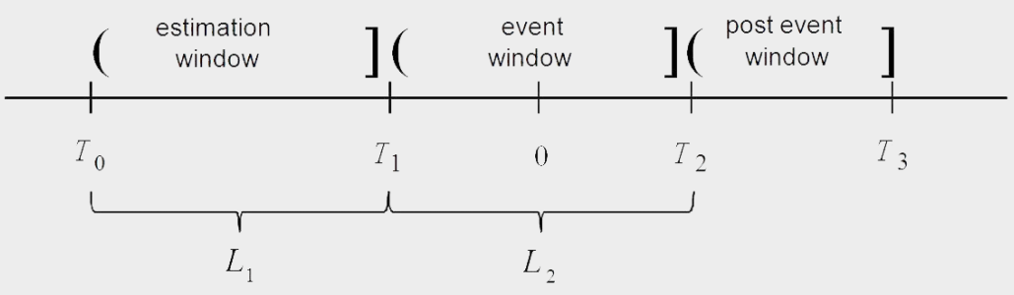
Eventus
3.
Normal return models are impacted by the time period by which the parameters are estimated. For example, the market model popularized by Ball and Brown in 1968 is a model in our paper that utilizes an estimated parameter. Given an event that occurs at time T=0, time periods L₁ and L₂ are used to restrict parameter estimation to market movements during the times T₀ to T₁. The specific estimation and event windows used by our models are discussed on the long and short run event study slides.
Return

Slide 14
Compustat Legend
4.
Financial Ratio | Definition | - 1 to 0 | -1 to 1 | - 3 to 0 vs. 0 to 3 Averages
Current Ratio | Current Assets / Current Liabilities | 43% | 41% | 63%
Return On Capital Employed | Profit Before Interest and Tax / Average Capital Employed | 38% | 36% | 59%
Return On Assets | Profit after Tax / Total Assets | 45% | 39% | 63%
Net Profit Margin | Profit after Tax / Sales | 43% | 36% | 70%
Total Debt Ratio | Total Debt / Total Assets | 66% | 66% | 70%
Interest Coverage Ratio | Interest / Profit Before Interest and Tax | 63% | 66% | 73%
Asset Turnover Ratio | Sales / Average Total Assets | 32% | 34% | 55%
Working Capital | Current Assets- Current Liabilities | 46% | 50% | 66%
Return On Equity | Net Income / Equity | 54% | 45% | 63%
The table shows the percent of the 55 companies that had a financial ratios improve in the time period evaluated. Although Compustat does not have information on many of the companies involved in transactions, it has substantial information on a limited number of Acquirers and their financials in the years prior/post an acquisition. Using the seven years financial information of companies involved in an acquisition (transaction year being year 0), the table to the left was put together. Although its conclusions are limited, it offers insights into performance of a company after an acquisition.
Return

Slide 15
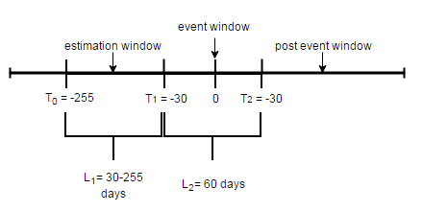
Short Run Event Studies (in days)
5.
Relatively problem free and intuitive.
Significance tests are readily available and problem free.
I’ve selected the parametric Patell test (Patell 1976) and the non-parametric generalized sign Z (Cowan 1992) for testing short run abnormal returns.
The estimation and event window for the short run are shown below.
As shown in the diagram, the estimation window ranges between 30-255 days. This takes place during the time period L₁, 30 days before the event. The event window, L₂, consists of the thirty days before and after the event. Abnormal returns are calculated from this time period.
Return

Slide 16
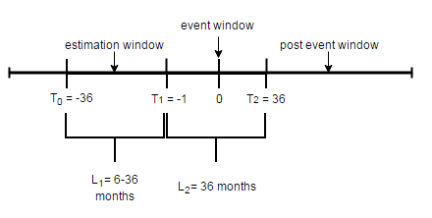
Long Run Event Studies (in months)
6.
Long run event studies are far more treacherous for multiple reasons.
Statistical tests are wrought with biases and limitations. The proper means of overcoming these obstacles is hotly debated in financial literature currently.
Assumptions regarding parameters of a company are extended over longer periods of time. This can cause issues.
The graphic below shows the long run estimation and event windows.
As shown in the diagram, the estimation window ranges between 6 and 36 months. This takes place during the time period L₁, 1 month before the event. The event window, L₂, consists of the month before the transaction and the thirty-six after it. Abnormal returns are calculated from this time period.
Return

Slide 17
Market Model
7.
The market model for normal returns is mathematically shown as:
Where E(R_{jt}) is the expected real return for company j at time t, β_{t} is responsiveness to changes in the market return, R_{mt} the market return at time t, and α_{t} unique company conditions impacting return.
Abnormal returns are thus calculated as:
Where R_{jt} is the real return for company j at time t.
This is one of the more popular normal return models.
Return

Slide 18
Market Adjusted Returns Model
8.
The market adjusted model for normal returns is mathematically shown as:
This is one of the simplest normal return models.
It has the advantage of not making any assumptions or using any OLS regressions to estimate parameters for calculating returns.
Its literally the difference between a company’s return and the market.
Return

Slide 19
Transaction Groups
9.
Our hypotheses are that certain factors are influencing returns.
By grouping transactions by certain characteristics, we can look at particular populations and see if the deviate from the entire dataset as a whole. IF THERE ARE DEVIATIONS WE HAVE REASON TO INCLUDE THESE VARIABLES DESCRIBING THESE POPULATIONS IN OLS REGRESSIONS (or at least that’s my argument).
I have grouped them by relative size, industry, and value.
Industry is a binary variable, but in order to create groups for continuous variables like relative size or value, brackets were created using the findings on the next slide.
Next Slide

Slide 20
Value Grouping
9.
The graphs above show transaction percentile according to transaction value. Using these graphics and my discretion, four transaction value groups were created. They are very low value, 0-100; low value, 100-500; medium value, 500-5000; and high value acquisitions exceeding 5000 million.
Next Slide

Slide 21
Relative Size Grouping
9.
Similar to transaction value groupings, relative size categories are made by my discretion after reviewing the graph above. Note that this graph is inverted compared to the previous one. Also note that relative size is meant to proxy risk to the extent that a company acquiring a target with a relative size of 50% would be increasing its net sales by 50%. Such a large sales increase is expected to require financial restructuring and may be considered a risky venture by investors. Alternatively, it could be a strategic marketing move. Relative
size has been broken into low risk, 0-25% sales increase; medium risk, 25-75%; and high risk, 75%+.
Return

Slide 22
Windows for Returns
10.
Including multiple windows is IMPERITIVE for our justification regarding the abnormal returns we report and use in our OLS regressions.
The right window is a topic of debate in literature today.
It is only after comparing multiple windows that we can argue that investor perception and short run abnormal returns appear concentrated around the time period (0,+1) days. This is how we choose our abnormal returns for our regressions!!!
Window | Mean CAR | Patell | Generalized Sign Z
(-5,+5) | 1.00% | 1.205 | 1.447$
(-1,+2) | 0.80% | 0.858 | -0.316
(0,+1) | 0.97% | 2.077* | 0.272
(0,0) | 0.06% | 0.215 | -0.022
Return

Slide 23
Selecting Abnormal Returns
11.
The Patell test and generalized sign z provide justification for the selection of abnormal returns.
This is important because we should have a reason why we chose the window (0,1) days.
We are also able to compare and contrast the abnormal returns reported by each model.
Differences from model assumptions are exacerbated in long run returns.
Return

Slide 24
OLS Regressions
12.
Because of our analysis of groups or sub-populations of our data, we have reason to believe that these characteristics are impacting the returns of acquirers and targets.
We perform OLS regressions in an attempt to test if these are significant and determine their impact on returns.
Short run regressions should have more significant variables than long run regressions as much of the ‘noise’ added during the passage of time is absent.
Return

Slide 25
Windows in the Long Run
13.
In the long run, we’re SEVERELY limited in what we should say. Lets look at several windows of our models in the long run. Note, significance has been omitted because there are few practical methods for testing long run returns.
The table below shows mean compounded abnormal returns.
Months | Market Model Returns | Market Adjusted Returns
(-1,0) | 0.76% | 2.39%
(0,+6) | -4.97% | 3.59%
(0,+12) | -19.61% | -0.90%
(0,+24) | -63.95% | -11.01%
(0,+36) | -135.73% | -19.72%
Next Slide

Slide 26
Windows in the Long Run
13.
To clarify, the differences between the models change based on what event windows, estimation periods, and transactions I am using.
However, we should be VERY hesitant to use the market model in the long run.
The β_{t} (responsiveness to the market return parameter) in the market model DOES provide us information about the companies analyzed, but it averages below one for most companies.
Should we expect a company that acquires (a risky venture) to continue varying with the market in the same way three years into the future?
It seems that the results are excessive, suggesting that the market model is not accurately reflecting reality.
Note, compounding exacerbates negative returns, but is argued as most appropriate in the literature.
Return

Slide 27
Weak Statements
14.
Our current long run returns should be subject to much skepticism.
Performing OLS regressions on poorly justified returns will NOT improve the quality or meaning of our analysis.
It is not incorrect, however. But it should be stressed just how weak our conclusions are given the apparent accuracy of our normal return models.
This is why I have been trying to gravitate away from a long term focus. I don’t think it has been clearly established just how ambitious long run analysis is with our data.
Return

Slide 28
Conclusions
15.
We do have multiple definitive conclusions.
A) Acquirer’s do not appear to loose or gain greatly in M&A transactions.
B) Target firms have significant gains in M&A transactions.
C) Returns by industry do differ according to our windows and groupings.
D) Particular gains from the factors analyzed are very ambiguous. This suggests that M&A transactions are very complex and are not easily described by the variables selected.
Return

